Slide 1
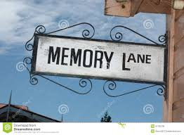
A Trip Down Memory Lane

Slide 2
The Rotary Club of Canterbury “Let’s Stay Connected Project” has been developed as a response to an identified need within the Aged Care sector.
At times when it’s difficult to connect in person with family and friends, the Rotary Club of Canterbury has pleasure in offering you this booklet, designed to promote conversation, recollection and engagement for those who are in isolation and without their usual social activities.
The booklets have been designed for people in an aged care residence, village or at home to read by themselves, or to have a family or staff member share the booklet with them.
You can download this and other booklets from the Rotary Club of Canterbury website (www.canterburyrotary.org.
Source references for this book are held at the Rotary Club of Canterbury. Contact president@caterburyrotary.org for further details.
Material in this book was reproduced in accordance with Section 113F of the Copyright Act (1968).

Slide 3
80 years of life in Australia 1940 to 2020
I hope these reminders jog your memory of events and things that may have happened to you, too, during the last 80 years.
Carolyn

Slide 4
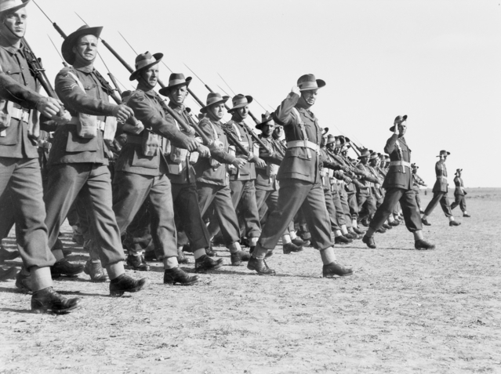
1940s
The Australian military had fought in World War 2 for a year. We wished our troops good luck and tearfully waved them goodbye.
Notes:
https://www.abc.net.au/btn/classroom/australias-involvement-in-wwii/12531804
https://www.awmlondon.gov.au/battles/kokoda

Slide 5
1940s
Our troops fought bravely on the difficult Kokoda Trail in Papua New Guinea.

Slide 6
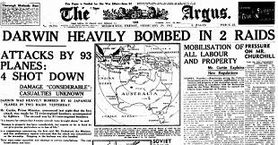
1941 and 1942
Japan entered the war in 1941.
Darwin was bombed in 1942.
Notes:
1. https://thebombingofdarwinww2.weebly.com

Slide 7
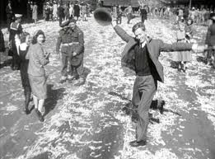
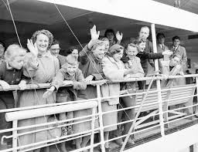
1945
World War 2 ended. There were parties in the streets.
Post-war
immigration began. Lots of British people and Europeans came here to build a better life.
Notes:
https://www.cairnspost.com.au/business/companies/hills-hoist-clothesline-intellectual-property-sold-off-to-usbased-company/news-story/d52c0e64bd79ce1e254739f428b3e7bb
http://cordite.org.au/essays/woolf-wex-man/
https://www.nma.gov.au/defining-moments/civics-and-citizenship-history-timeline

Slide 8
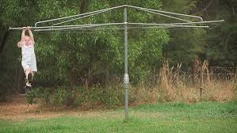
1945
The Hills Hoist was invented. Children used to swing on it whether there was washing on it or not!

Slide 9
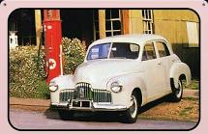
1948 and 1949
The first Australian-made car –the Holden was manufactured.
Also:
In the late 1940s, the United Nations was founded.
The antibiotic, penicillin was developed. What a life saver!
Notes:
https://garageart.com.au/holden-48-215-the-first-holden-tin-metal-sign
https://www.google.com/imgres?imgurl=https://alchetron.com/cdn/snowy-mountains-scheme-bf8597f0-46a0-4956-abe5-34c9d3201f7-resize-750.jpeg&imgrefurl=https://alchetron.com/Snowy-Mountains-Scheme&h=535&w=650&tbnid=eJaTcJxG_G2KzM&tbnh=204&tbnw=248&usg=AI4_-kRSFTjAQR9ajvmO3f4i4P_8cyftOQ&vet=1&docid=DoO6kYnZw4T_TM/

Slide 10
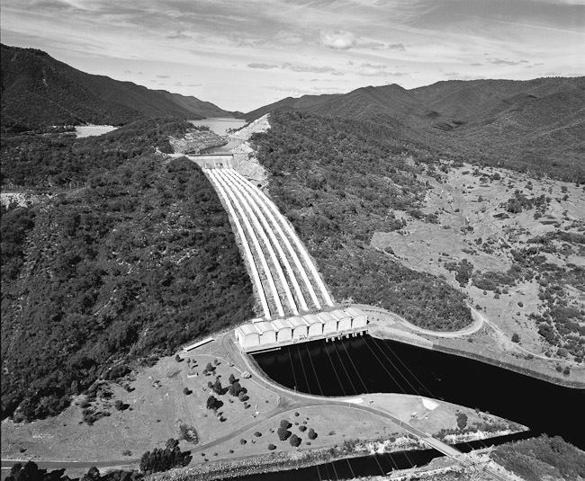
1948 and 1949
In 1949, the Snowy Mountains Hydro-Electric Scheme began.
My father was an engineer on this project.

Slide 11
1950s
Some interesting facts:
Robert Menzies was elected Prime Minister in 1949.
The Korean War lasted from 1950-53. 17,000 of our troops served in this war.
The School of the Air was established in 1951.
The Petrov spy affair was exposed in 1954.
Notes:
1. https://www.realestate.com.au/news/retro-revival-sees-buyers-embrace-the-suburban-classic-brickveneer-home/

Slide 12
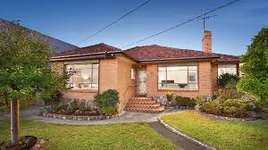
1950s
The 1950’s suburban, cream brick veneer average house price was £7,400.00
A car cost $1500.00
Essendon defeated North Melbourne in the VFL in 1950.
‘Singing in the Rain’ and ‘High Noon’ were the hits in 1952
Milk cost 20c a quart

Slide 13
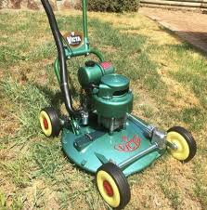
1952 to 1954
In 1952 the Victa lawn mower was invented and it meant no more pushing and pulling the hand mower.
My Dad loved his Victa mower!
Notes:
https://www.pinterest.com.au/pin/673147475544443528/
https://www.historic-newspapers.com/blog/queen-elizabeth-ii-the-early-years/

Slide 14
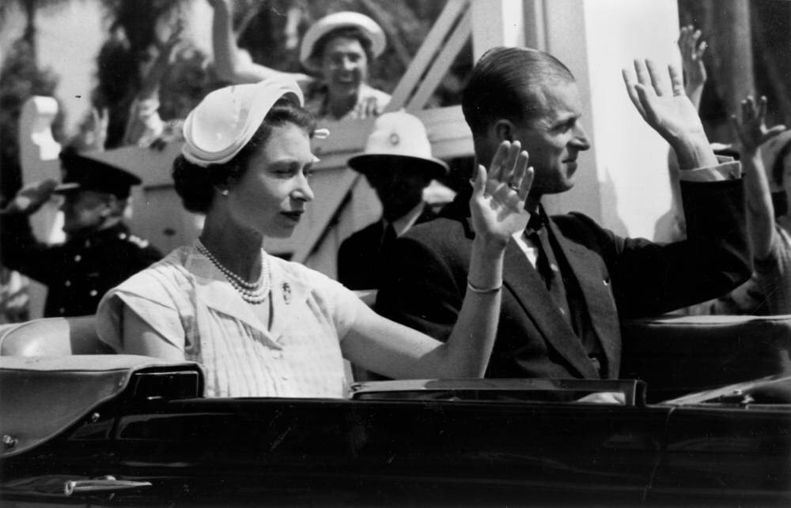
1952 to 1954
Australia was very excited by the 1954 Royal Tour.

Slide 15
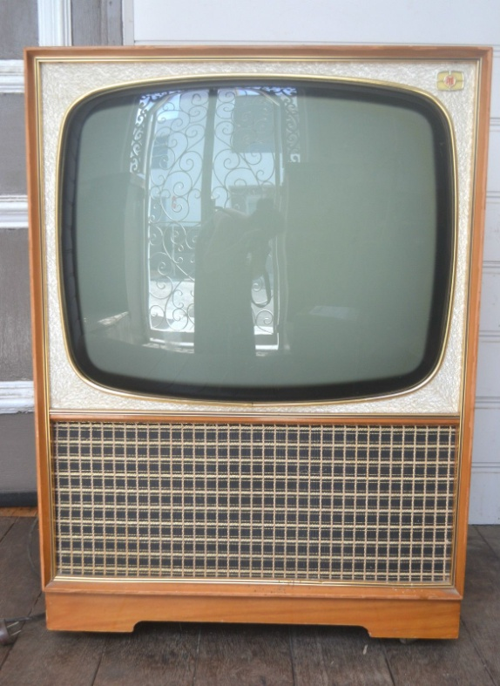
1956
Television came to Australia in time for the Melbourne Olympic Games. Pictures were in black and white only!
Notes:
https://www.pinterest.com.au/pin/380413499758196837/
https://theculturetrip.com/pacific/australia/articles/a-brief-history-of-the-melbourne-1956-olympics/

Slide 16
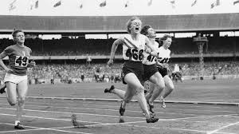
1956
In 1956, Melbourne hosted the Olympic Games. Athletes like Betty Cuthbert, and our swimmers did us proud.

Slide 17
Some more interesting facts and inventions in the 1950s
1956
The polio vaccine was given to children.
Teeth braces were first used.
In 1958 the first skyscraper was built in Australia.
The aeroplane black box recorder was invented in Australia.

Slide 18
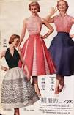
1960s
Some interesting facts about the sixties
The use of plastic spectacle lenses began.
In 1961 the contraceptive pill was introduced
Ultrasound was first used in this decade.
In 1964 the Beatles toured Australia.
We voted for indigenous people to be included in our census.
Rod Laver won the singles Grand Slam again.
The White Australia Policy ended in 1966.
But only Georges represented international fashion and style in Melbourne
Notes:
https://www.pinterest.com.au/celinebaensbasilio/fashion-dresses/

Slide 19
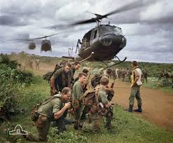
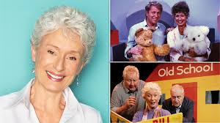
1965 and 1966
In 1965 our first troops were sent to
Vietnam. It was a long and bitter war.
In 1966........
the iconic children’s TV show Playschool began on the ABC.
Notes:
https://docplayer.net/61375764-A-duty-done-a-summary-of-operations-by-the-royal-australian-regiment-in-the-vietnam-war-by-lieutenant-colonel-retired-fred-fairhead.html211
https://cdn.newsapi.com.au/image/v1/4a9c0056d0bf2e223580b43982694c19
https://www.stampboards.com/viewtopic.php?f=13&t=68489

Slide 20
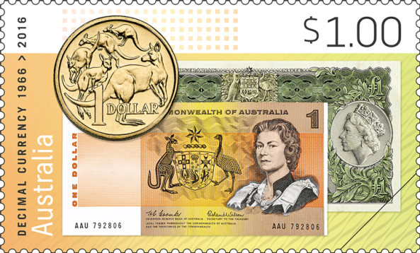
1965 and 1966
We switched to decimal currency on the 14th February 1966.
Do you remember the jingle sung by Dollar Bill?

Slide 21
In the 1970s
Carlton defeated Collingwood in the VFL.
‘Bridge Over Troubled Water’ was the top hit song.
‘Planet of the Apes’ and ‘Catch 22’ were popular films.
‘Chorus Line’ and ‘Annie’ were popular musicals.
‘Let It Be’ was the best selling Beatles album.
The book, ‘The Chrystal Cave’ by Mary Stewart sold well.
The average wage was $6,000.00 and the
average house cost $30,000.00.
Holden cars sold more than Fords.
The book ‘The Female Eunuch’ by Germaine Greer was published.
Equal pay for women was legislated. Hooray!
The Great Barrier Reef was proclaimed a Marine Park.
Martin Cooke (baritone) as St Peter in Il Lutto dell'Universo -The Mourning of the Universe

Slide 22
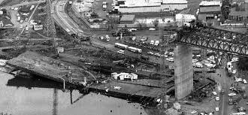
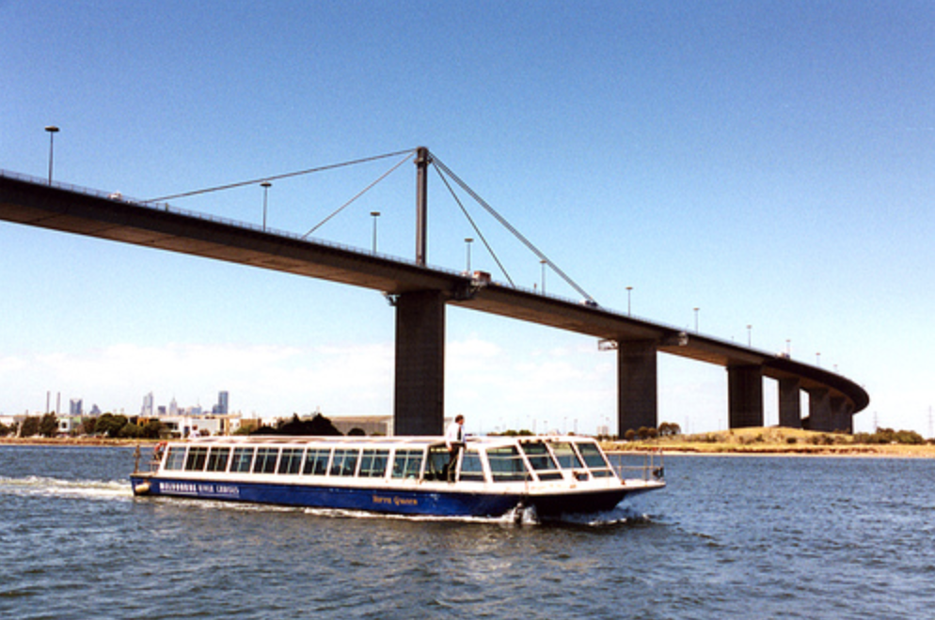
1970s
During construction of the West Gate Bridge in 1970 a span collapsed. It cost 35 lives.
The West Gate Bridge was completed in 1978.
Notes:
https://pocketozmelbourne.com.au/westgate-bridge.html
http://bestbridge.net/Australia_en/west-gate-bridge.html

Slide 23
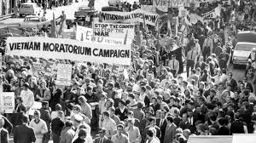
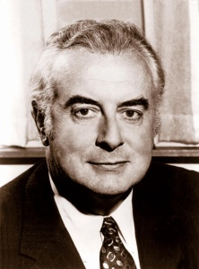
In 1972 Gough Whitlam was elected Prime Minister. He ended conscription and brought the troops home.
The Vietnam War
Around Australia, ‘Moratorium’ marches were held to protest against our troops being in the Vietnam War.
In 1972 Gough Whitlam was elected Prime Minister. He ended conscription and brought the troops home.
Notes:
https://commonslibrary.org/the-vietnam-war/
https://www.imdb.com/name/nm0926042/

Slide 24
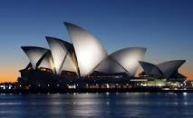
Highlights of the 1970s
In 1973 the magnificent Sydney Opera House was opened.
Notes:
https://depositphotos.com/stock-photos/sydney-opera.html
https://www.couriermail.com.au/news/image-gallery/0551338091f9ec9646dc6fdfab2da0ed?page=33
https://campaigns.premiers.qld.gov.au/queenslandday/timeline.aspx

Slide 25
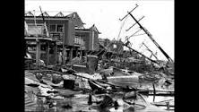
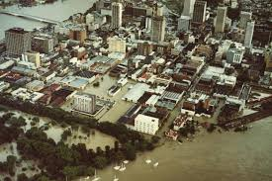
Highlights of the 1970s – the disasters
In 1974, at Christmas, Cyclone Tracy flattened Darwin. We were shocked to see the pictures on TV.
Another dire disaster was the Brisbane floods in 1974.

Slide 26
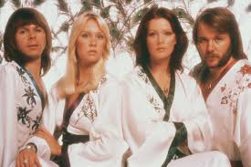
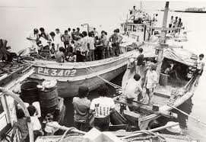
The late 1970s
In 1977, the Swedish pop group ABBA toured Australia.
In 1976, the first ‘boat people’ arrived from Vietnam.
Notes:
https://www.esquire.com/entertainment/music/g20084254/abba-photos/
https://www.nma.gov.au/defining-moments/resources/vietnamese-refugees-boat-arrival
https://www.traveller.com.au/10-things-in-australia-you-can-only-experience-by-train-gr3rbh

Slide 27
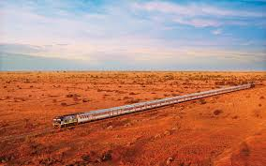
The late 1970s
Australia’s longest train trip on the ‘Indian Pacific’ began.
Sydney to Perth on this train is considered one of the world’s greatest train journeys.

Slide 28
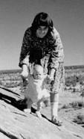
1980s
Near Uluru, Ayer’s Rock, as it was then called, baby Azaria Chamberlain disappeared.
Her mother, Lindy was jailed for her murder, but was later acquitted.
It has been accepted that a dingo took the baby.
Notes:
https://en.wikipedia.org/wiki/Death_of_Azaria_Chamberlain
https://www.abc.net.au/news/2017-09-07/waxit-wa-is-better-off-without-you-australia/8881428

Slide 29
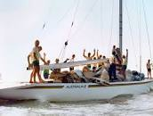
1980s
Australia beat the USA to win the America’s Cup in Perth in 1983. Graeme Bertrand was skipper and Alan Bond owned the boat.

Slide 30
1984
In 1984 various important things happened.
Medicare began, giving universal health care for all.
The first IVF baby was born.
Richmond defeated Collingwood in the 1980 VFL final
Uluru was handed back to the traditional owners
The Sex Discrimination Act was passed.
Polymer bank notes were introduced.
An average house cost $60,000.00
The average wage was $12,500.00
Advance Australia Fair became our National Anthem. Do you know all the words?
Eggs cost 84 cents a dozen
‘Breaker Morant’ was a popular film

Slide 31
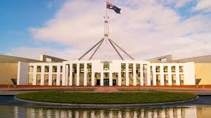
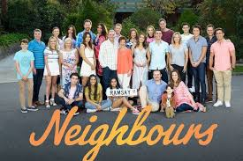
Australia’s new Parliament House was opened in Canberra in 1988. The opening coincided with the bi-centenary.
In 1985 a local Melbourne TV show began and was watched around the world!
Notes:
https://www.news.com.au/national/politics/chaos-will-continue-into-the-new-year-with-the-legitimacy-of-decisions-being-questioned/news-story/deb257d412b737fbd2c6b1c530c2b9df
https://www.amazon.com/s?k=neighbours&i=instant-video&ref=nb_sb_noss_1

Slide 32
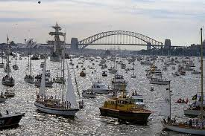
1988 – Australia’s Bi-Centenary
In 1988, the Bi-Centenary of British settlement was celebrated everywhere in Australia. Perhaps one of the most spectacular sights was the display of ‘Tall Ships’ on Sydney Harbour.
Notes:
https://www.timetoast.com/timelines/post-wwii-events-4a79d93e-98a1-41a1-927f-0c37cab0c1be
https://www.naa.gov.au/learn/learning-resources/learning-resource-themes/society-and-culture/sport-and-recreation/tall-ships-sydney-harbour-during-australian-bicentenary-celebrations
https://www.smh.com.au/politics/federal/cabinet-papers-198889-party-central-but-the-fun-had-to-stop-20141218-129v8j.html

Slide 33
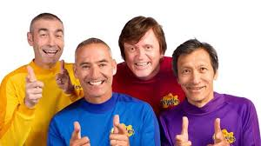
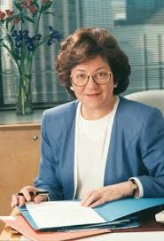
1990s
Children adored The Wiggles on TV and in live shows.
In 1990, Dr Carmen Lawrence became Australia’s first female State Premier.
Notes:
https://www.abc.net.au/news/2018-09-02/wiggles-jeff-fatt-zero-interest-childrens-music-soon-woke-up/10183224
http://john.curtin.edu.au/gallop/lawrence.html
https://www.youtube.com/user/PortArthurTasmania

Slide 34
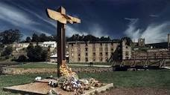
1990s
In April 1996, a deranged man, Martin Bryant, shot dead 35 people and wounded 23 more at Port Arthur, Tasmania. It was a black day in our history.
As a result, Prime Minister Howard brought in a gun amnesty. This act has greatly reduced the amount of gun violence in Australia.

Slide 35
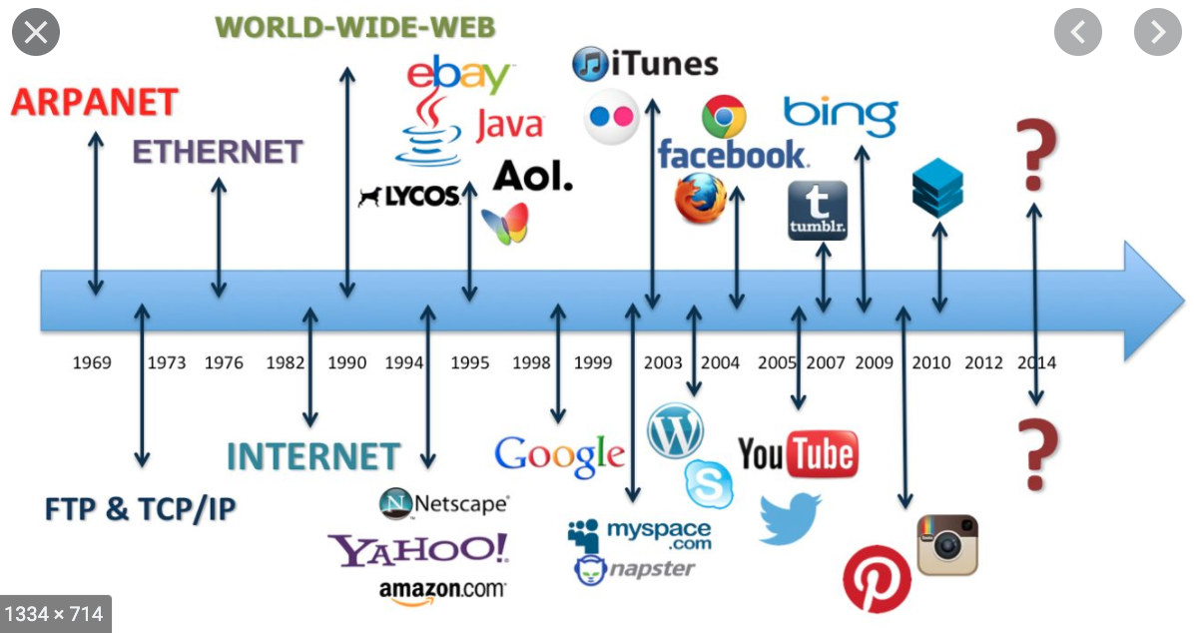
1990s
In 1994, public access to the internet and the World Wide Web, began.
At the end of the decade, many people worried whether the date changeover on computers at midnight 1999, would be a problem. Would the K20 Bug cause bank vaults to open? It didn’t!
.
.
Notes:
https://www.fightingfake.org.uk/resources-overview

Slide 36
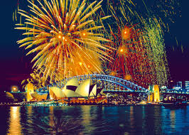
2000s
January 1st 2000 rang in the new year and the new millennium.
.
.
There were fireworks at midnight on Sydney Harbour and every capital city. Spectacular!
Notes:
https://www.fightingfake.org.uk/resources-overview

Slide 37
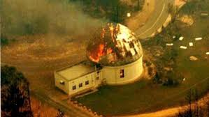
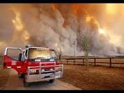
2000s
In 2003, Canberra was hit by terrible bushfires. The observatory was destroyed.
In 2009, South Eastern Australia was ravaged by severe bushfires on ‘Black Saturday’. 173 people died and over 2000 homes were lost. Our mighty volunteer fire fighters were magnificent.

Slide 38
2000s interesting facts
In 2002 Stephen Bradbury won an Olympic ice skating medal by being the last man standing.
A vaccine to prevent cervical cancer was released.
In 2007 there was a global financial crisis which started in USA and spread all over the world.
In 2008 there was a national apology by our Prime Minister, Kevin Rudd, to indigenous peoples.
An average house cost $195,000.00
Essendon defeated Melbourne in the Grand Final
It was a bumper time for musicals eg Moulin Rouge, Les Miserables, Chicago, Phantom of the Opera and Shrek.
The Holden Commodore was the most popular car in 2000

Slide 39
Let’s compare! 1901 Vs 2001
Item | 1901 | 2001
Loaf of bread | 2d | $4.60
2 kg sugar | 9d | $2.30
500gms butter | 13d | $2.00
1 kg onions | 12d | $1.25
Theatre ticket | 35d | $30.90
Newspaper | 1d | $1.00
Women’s shoes | £1.45 | $65.00

Slide 40
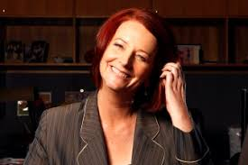
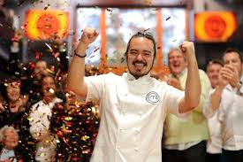
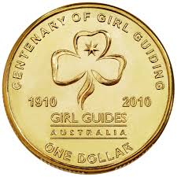
2010 - 2019
In 2010,
Julia Gillard was elected Australia’s first female Prime Minister.
Adam Liaw won Masterchef.
The commemorative one dollar coin for the 150th anniversary of Girl Guides Australia was minted.
At this time there were 17,500 Girl Guides, aged from 7-17.
Notes:
https://www.smh.com.au/politics/federal/from-the-archives-2010-australia-gets-its-first-female-pm-20200616-p55333.html
https://www.ramint.gov.au/sites/default/files/Becoming%20a%20coin%20collector.pdf
https://masoandads.wordpress.com/2010/07/28/tv-dinner-the-masterchef-washup/

Slide 41
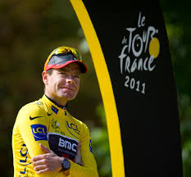
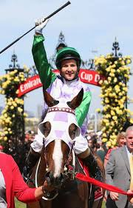
Some “firsts” for this decade
Cadel Evans was the first Australian to win the Tour de France.
Michelle Payne won the Melbourne Cup in 2015; the first woman jockey to do so.
Notes:
https://www.onlygeelong.com.au/cadel-evans#.X1DXyi17HOQ
https://www.thecourier.com.au/story/3469014/update-melbourne-cup-reception-coming-tomorrow/
https://www.cla.asn.au/News/popping-marriage-question/#gsc.tab=0
https://womens.afl/news/17219/it-s-do-or-die-for-demons-but-they-ve-been-there-before

Slide 42
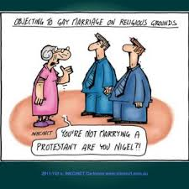
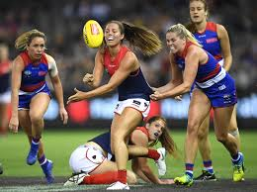
Some “firsts” for this decade
The Marriage Equality Act was passed in Parliament in 2017
The first season of Women’s Australian Rules Football League began in 2017.

Slide 43
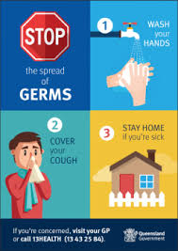
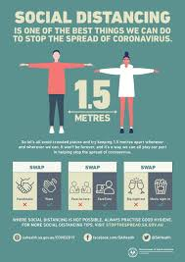
2020
The year of the COVID Pandemic. What an awful year!
Let’s hope next year we can see our family and friends and hug each other. I hope we don’t have to wear face masks and stay apart.
Let us give thanks for scientists and health professionals.
Notes:
https://www.qld.gov.au/__data/assets/pdf_file/0014/120812/qh-stop-spread-germs-poster.pdf
https://www.health.gov.au/resources/publications/coronavirus-covid-19-print-ads-good-hygiene-is-in-your-hands
https://www.mga.asn.au/coronavirus/coronavirus-covid-19-posters-for-download-display
https://www.mga.asn.au/coronavirus/coronavirus-covid-19-posters-for-download-display

Slide 44
I hope you have enjoyed our trip down Memory Lane and it has reminded you of people and events over your life.
We have looked at lots of changes from 1940 until now.
I hope you have found the pictures and information interesting.
I have had great fun putting it together for you to read.
Carolyn

