Slide 1
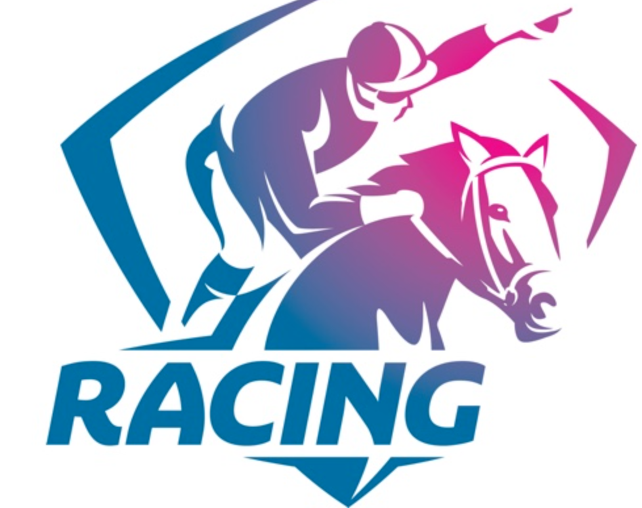
Horse Racing in Victoria
Following the Nags
Notes:
1. https://www.igsrv.org/regulatory-veterinarian-(2-positions)-with-racing-victoria

Slide 2
The Rotary Club of Canterbury “Let’s Stay Connected Project” has been developed as a response to an identified need within the Aged Care sector.
At times when it’s difficult to connect in person with family and friends, the Rotary Club of Canterbury has pleasure in offering you this booklet, designed to promote conversation, recollection and engagement for those who are in isolation and without their usual social activities.
The booklets have been designed for people in an aged care residence, village or at home to read by themselves, or to have a family or staff member share the booklet with them.
You can download this and other booklets from the Rotary Club of Canterbury website (www.canterburyrotary.org).
Source references for this book are held at the Rotary Club of Canterbury. Contact president@caterburyrotary.org for further details.
Material in this book was reproduced in accordance with Section 113F of the Copyright Act (1968).

Slide 3
Horse Racing In Victoria
Hi, my name is Anne Murphy and I am a member of the Rotary Club of Camberwell.
I wrote this book about horse racing as the topic was specifically requested.
Several members of my extended family and friends are involved in horse racing as breeders, trainers, regulators and owners.
The topic occupies a lot of time at family gatherings.
I hope the colourful history helps wile away the time.
Anne

Slide 4
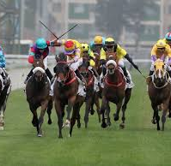
Horses and Jockeys - a partnership
Rotary Club of Canterbury: Let's Stay Together Project
Notes:
sport-betting-1-350x204.jpg

Slide 5
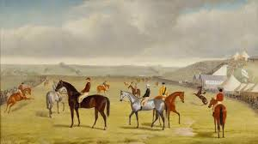
Early Days
Horse Racing in Australia began in
Victoria in 1848.
Rotary Club of Canterbury: Let's Stay Together Project
Notes:
toryboy_melbourne_cup_0.jpg

Slide 6
Early Days
Tracks were not as well designed or professionally prepared like they are today.
Races, too, place in paddocks or any other open, flat space.
Notes:
toryboy_melbourne_cup_0.jpg

Slide 7
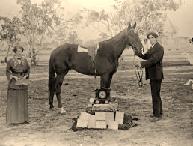
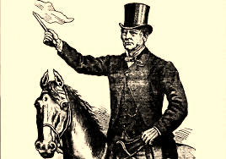
Early Days
Conditions were not as sophisticated as they are now, but punters still loved the prizemoney.
Notes:
https://westerndistrictfamilies.com/2020/02/26/take-a-photo-daystar/
https://blog.qm.qld.gov.au/2017/11/02/george-watson-and-the-melbourne-cup/

Slide 8
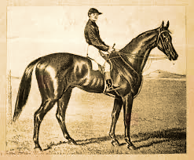
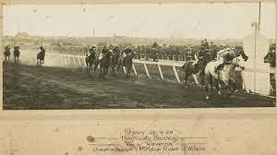
Archer
Archer (1856–1872) won the first and the second Melbourne Cups in 1861 and 1862.
Horses have been bred to be winners over centuries, with most b;oodlines traceable back to English ‘taproot’ mares identified in the first General Stud book in 1793.
Notes:
https://en.wikipedia.org/wiki/Archer_(horse)
turfmate.com.au

Slide 9
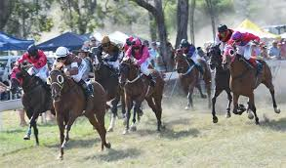
The First Racetracks
By the late 19th century most major towns had proper racetracks.
Melbourne’s first racecourse was on Batman’s Hill on the site now occupied by Southern Cross railway station and the rail yard west of the Central Business District.
Its first meeting was in March 1838.
Notes:
horsebetting.com.au

Slide 10
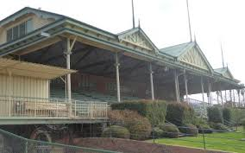
The First Racetracks
The Batman Hill racecourse predated the now famous Flemington racecourse by two years.
The starting post at Flemington was near the present-day North Melbourne railway station.
Notes:
vintagevictoria.net.au

Slide 11
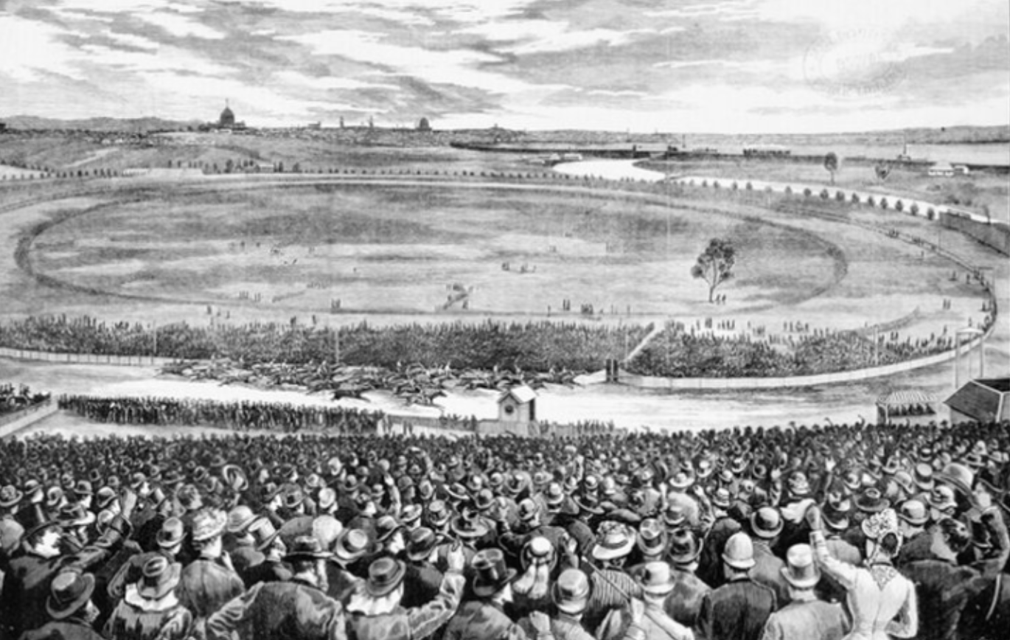
Flemington Racecourse
The city of Melbourne was founded in 1835. Five years later, a racecourse was laid and was known as the Melbourne course. It became known as Flemington, after the first landowner, James Watson, named it after his wife’s property in Scotland.
The first race meeting was held along the rough river flats beside the Maribyrnong River on March 3, 1840.
Rotary Club of Canterbury: Let's Stay Together Project
Notes:
From the State Library of Victoria collection

Slide 12
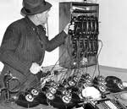
SP Bookies
Special Price or SP bookies were a feature of local neighbourhoods in the early and middle 1900’s - some just operating from the kitchen table and using young boys as runners to collect and deliver bets and winnings.
Notes:
http://online.sfsu.edu/hl/g.bk.html

Slide 13
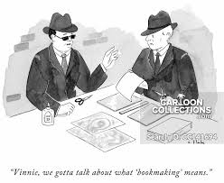
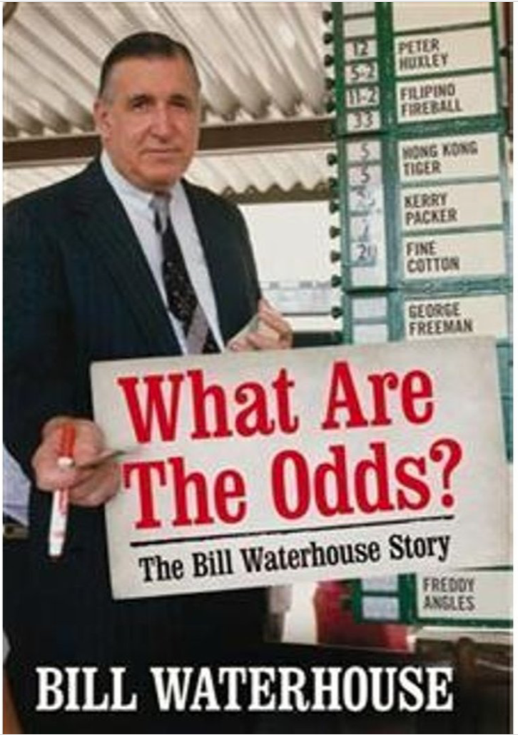
New Ways to Bet
Face-to-face interaction in the betting ring, the ultimate battleground between bookie and punter, is no longer as relevant in horse racing with the advent of betting agencies.
Notes:
https://www.penguin.com.au/books/what-are-the-odds-the-bill-waterhouse-story-9781741666311
https://www.newyorker.com/wp-content/uploads/2015/04/150420_a18969.jpg

Slide 14
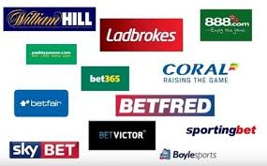
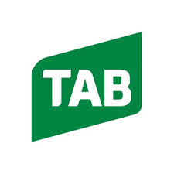
Totalizer Agency Board - TAB
Betting began being more regulated in 1961 with the advent of the TAB, then a state-owned monopoly betting organization.
Today the TAB has been privatized and there are a multitude of corporate betting agencies.
The majority of betting is now done online.

Slide 15
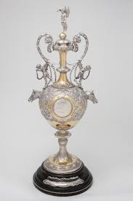
The Melbourne Cup
The first Melbourne Cup was in 1861. Today it is the richest handicap race in Australia and the prizemoney and trophies make it among the richest in the world. It is a 3200 metre, or 2 miles, race.
Notes:
https://www.nma.gov.au/explore/collection/highlights/1866-melbourne-cup

Slide 16
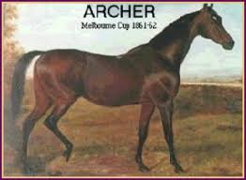
The Beginning Of A Horse Racing Legend
Archer (1856–1872) was an Australian Thoroughbred racehorse who won the first and the second Melbourne Cups in 1861 and 1862. He won both Cups easily and is one of only five horses to win the Melbourne Cup twice or more; he is one of only four horses to win two successive Cups.
Notes:
https://www.betsfree.com.au/archer

Slide 17
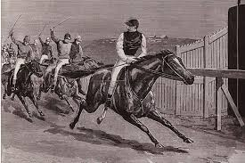
Carbine Won The Melbourne Cup In 1890
Carbine was a New Zealand thoroughbred. “Five to one bar none” was the bookies cry when taking odds on Carbine’s races.
Notes:
https://www.abc.net.au/news/2015-11-03/melbourne-cup-history-of-australian-horseracing/6908252

Slide 18
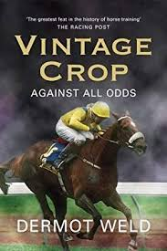
The First International Melbourne Cup Winner
Horses from all over the world now travel to race in the Melbourne Cup on the first Tuesday in November.
Vintage Crop was the first international horse to win in 1993.
Notes:
https://www.abebooks.co.uk/book-search/author/dermot-weld/

Slide 19
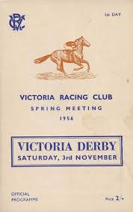
Victoria’s Famous Horse Races
The Victoria Derby, is a Victoria Racing Club Group 1 Thoroughbred horse race for three-year-olds . It is run over a distance of 2,500 metres at Flemington Racecourse, on the first day of the Melbourne Cup Carnival - Victoria Derby Day.
The racebook for 1956 Victoria Derby that included the famous triple dead heat in the Hotham Handicap.
Notes:
tours/160627-2015-cox-plate-trophy-slider/
https://www.carters.com.au/index.cfm/item/778430-racebook-for-1956-victoria-derby-that-included-the-famous-triple

Slide 20
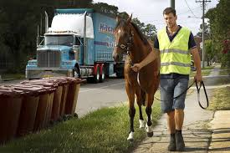
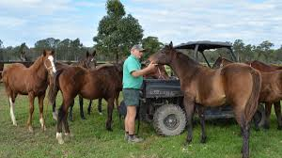
Where the Money Is…..
The horse racing industry is worth $3.2 billion to the Victorian economy. There are around 25,000 full time jobs.
Other states like NSW, Queensland & WA have equally large racing industries.
Notes:
https://www.liverpoolchampion.com.au/story/2036683/warwick-farm-horse-trainers-want-new-road-built/
https://nnimgt-a.akamaihd.net/transform/v1/crop/frm/storypad-Bym9XyjaRTgU82FcsB2xwD/b5fc4824-15ac-4e2e-bb94-d807a59ef7e4.JPG/r370_490_3897_2468_w1200_h678_fmax.jpg

Slide 21
Thoroughbred Racing Jobs In Victoria
Breeders 2,100
Breeders Staff 2,200
Owners & Syndicate Members 70,000
Trainers 950
Jockeys 250
Stable Employees 3000
Full Time Racing Club Staff 860
Racing Club Staff 4,800
Wagering Provider Staff 2,000
Bookmakers & Staff 950
,

Slide 22
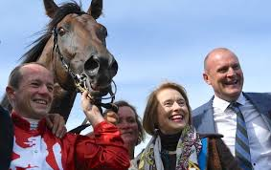
The “First Lady” of Australian Racing
Gai Waterhouse is considered to be the “First Lady” of Australian horse racing. She was the first Australian female trainer to win the Melbourne Cup with Florente in 2013.
Gai Waterhouse is the second from the right in the photo. The horse is Runaway.
Notes:
https://practicalpunting.com.au/News-Articles/Waterhouse-happy-with-Cup-runner-Runaway

Slide 23
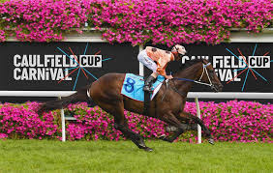
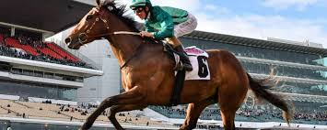
Caulfield Racecourse
CAULFIELD RACECOURSE, commonly known as "The Heath" by local racegoers, is on Crown Land in Melbourne’s south eastern suburbs. The Melbourne Racing Club has a license to operate the course but also owns adjoining land.
Notes:
https://r-co.com.au/wp-content/uploads/2018/11/Caulfield-Cup-Carnival-1a.jpg
https://dnu5embx6omws.cloudfront.net/photos/news/humidor-is-one-of-nine-rides-for-damian-lane-1508459645_636x424.jpg

Slide 24
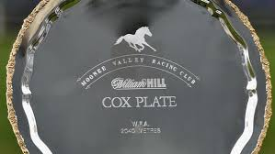
Moonee Valley Hosts The Cox Plate
Moonee Valley Racecourse was established in 1883 by William Samuel (W.S.) Cox.
He purchased a farm the previous year belonging to John F. Feehan, for the purpose of establishing a racetrack.
The Cox Plate is run at Moonee Valley over 2040 metres. The race is Australia's richest weight-for-age race for horses 3 years old and over.
Notes:
https://ambassadortravel.com.au/horse-racing-tours/2020-cox-plate-carnival-racing-tour/2020-cox-plate-tour-1/mvrc-manikato-stakes-moonee-valley-racecourse/

Slide 25
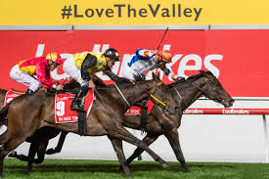
The Valley
Expansion of the racecourse occurred in the 1960s, funded by compensation for land acquired for the construction of the adjacent Tullamarine Freeway.
In the 1970s harness racing moved to the Valley, when night trotting relocated from the Royal Melbourne Showgrounds.

Slide 26
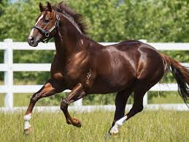
Horse Birthdays
All thoroughbred horses celebrate their birthday on the same date - January 1 in the Northern hemisphere and August 1 in the Southern hemisphere.
Notes:
https://www.bloodhorse.com/horse-racing/articles/239910/written-tycoon-joins-arrowfield-stud-roster

Slide 27
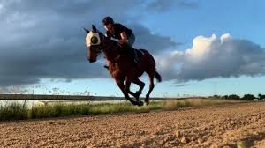
RACING PARLANCE
Barriers: The gates the horse comes out of at the start of a race
Birdcage: The area where horse are walked before being taken to the Mounting Yard
Blinkers: The hood horses wear with cups around their eyes
Bookmakers/Bookies: The people licensed to place your bet. Can be on-course or off-course
Box Trifecta: Usually four or five horses are "boxed" in a trifecta. If three of the horses selected all finish in the first three placings, the punter collects for a winning trifecta.
Colt: A male horse under three years old, that hasn't been gelded yet
Notes:
https://www.dailymercury.com.au/topic/mackay-turf-club/

Slide 28
RACING PARLANCE
Dead Heat: A tie at the finish line between two or more horses.
Each way: This is when you have an equal amount of money on the horse for a win and for a place.
Exacta: Picking the first two horses in a race in the finishing order.
Extended: How to describe a horse running at top speed.
Favourite: The most popular horse in betting by weight of money and therefore the one who starts at the shortest odds i.e. the one that will pay the least.
Notes:
https://www.dailymercury.com.au/topic/mackay-turf-club/

Slide 29
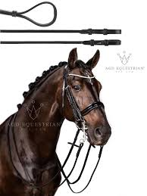
RACING PARLANCE
Filly: A female horse three years old or under.
Late Scratching: A horse that is withdrawn from the race after 8 a.m. on race day.
Lay: When a bookmaker offers better odds on a horse they think won't win.
Maiden: A horse which has not won a race
. Mare: Adult female horse four years of age or older.
Mounting Yard: The area where the horses are paraded right before a race and jockeys get on.
Mudlark: A horse that does well on wet tracks.
Mug Punter: Someone who's bad at betting.
Notes:
https://www.agdequestrian.com.au

Slide 30
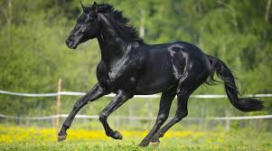
RACING PARLANCE
Head/half head: Winning margin equated to the length of a horse’s head or part thereof
Nose: The smallest measuring margin between horses. If a horse wins by a nose, it was an incredibly close race.
Odds-Against: The prices in the betting ring are longer than even money (e.g. $4 for $1 invested).
Odds On: Odds of less than even money.
Photo Finish: A result so close they need to look at the pictures taken by the finish-line camera to determine the winner.
Notes:
https://www.horsetalk.co.nz/2016/08/08/horse-shiny-healthy-coat-skin/

Slide 31
RACING PARLANCE
Place: When your horse comes either first, second or third and you receive a dividend (No third place dividend unless at least 8 starters.)
Punter: Person placing a bet
Quadrella: (Quaddie) When you select the winner of four pre-nominated races on the card
Quinella: Select the first two horses in a race in any order.
Runner: What you call a horse in the race.
Scratching: A runner that has been be taken out of the race after being listed as a runner.
Notes:
https://www.horsetalk.co.nz/2016/08/08/horse-shiny-healthy-coat-skin/

