Slide 1
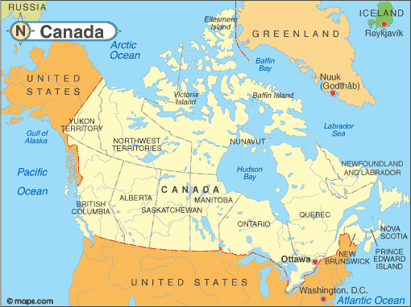
Exploring Canada
Notes:
https://res.cloudinary.com/fen-learning/image/upload/c_limit,w_510,h_382/infopls_images/images/mapcanada.gif

Slide 2
The Rotary Club of Canterbury “Let’s Stay Connected Project” has been developed as a response to an identified need within the Aged Care sector.
At times when it’s difficult to connect in person with family and friends, the Rotary Club of Canterbury has pleasure in offering you this booklet, designed to promote conversation, recollection and engagement for those who are in isolation and without their usual social activities.
The booklets have been designed for people in an aged care residence, village or at home to read by themselves, or to have a family or staff member share the booklet with them.
You can download this and other booklets from the Rotary Club of Canterbury website (www.canterburyrotary.org).
Source references for this book are held at the Rotary Club of Canterbury. Contact president@caterburyrotary.org for further details.
Material in this book was reproduced in accordance with Section 113F of the Copyright Act (1968).

Slide 3
Hello
My name is David and I’m a member of the Rotary Club of Canterbury in Melbourne, Australia.
I am in my mid eighties and retired from business 12 years ago. I had never considered cruising as a holiday. Then, in 2009, my partner, Nola, and I decided to take the tour to Canada, and we enjoyed it immensely. I would like to share some of the highlights of our trip with you.
Kind regards
David

Slide 4
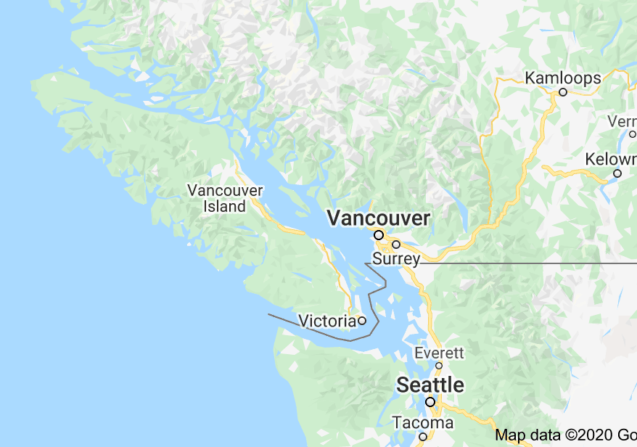
Vancouver Island
Our Canada adventure began when we flew from Melbourne to Vancouver via Los Angeles. From there we travelled on to scenic Victoria, the largest city on Vancouver Island.
Notes:
Author’s own photograph (of a postcard)
https://www.google.com/maps/vt/data=khCrJlRU39c08Rhj9guxk_s2_uE6hQyV_TMFWZXn_Xp_K6zdBE3infsHHQSw2ufePj5Gjz5eDJf5CtMjdjF2vARoJi9_pVJoVVBNGZzU_5nZNOitWcqQqpAp7rzXPrJCUf3MPZ5nt84BIPbOokmUFtbl2TO6OqZ5fY_Z5TGHU-xhuXbP34vKHY2Fg7ReDAfhXbs_CNMfblDG2ffIhGSFT50jwND6N9Ro2rUMuab5i-_THzf6mhKmRrmu

Slide 5
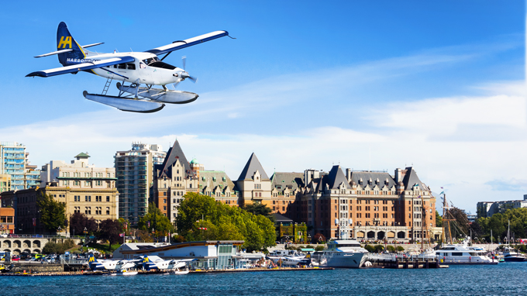
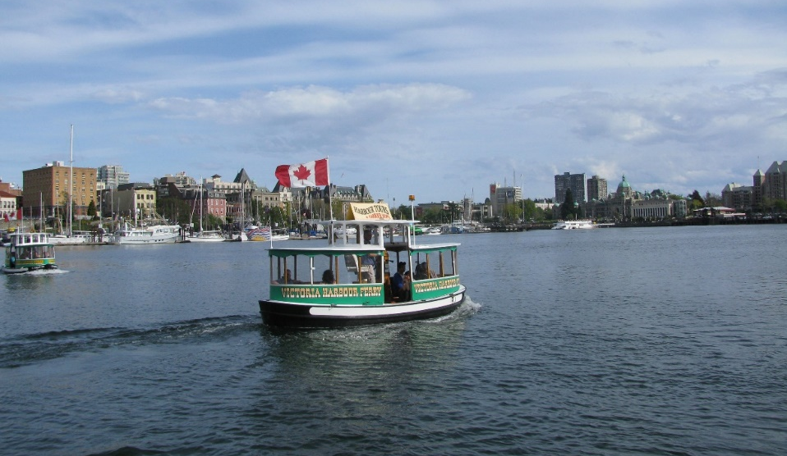
Vancouver Island
There were small seaplanes and water taxis for sightseeing.
Notes:
Author’s own photograph
Author’s own photograph

Slide 6
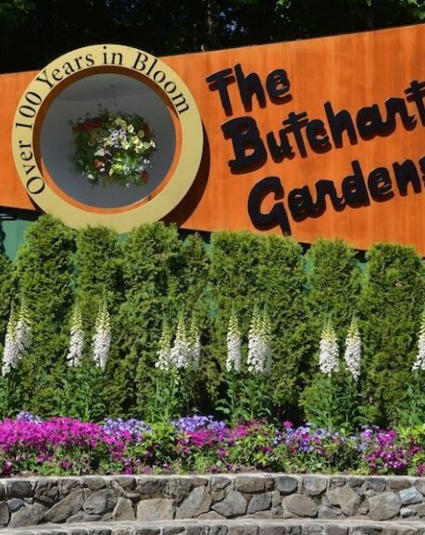
Butchart Gardens
One of our real highlights was a visit to the Butchart Gardens. You can see the entrance in this photo.
There are 63 acres of the most magnificent gardens.
Notes:
https://i0.wp.com/welltravelled.com.au/wp-content/uploads/2018/06/Spring-in-the-gardens-Image-credit-the-Butchart-Gardens.jpg?resize=770%2C578&ssl=1

Slide 7
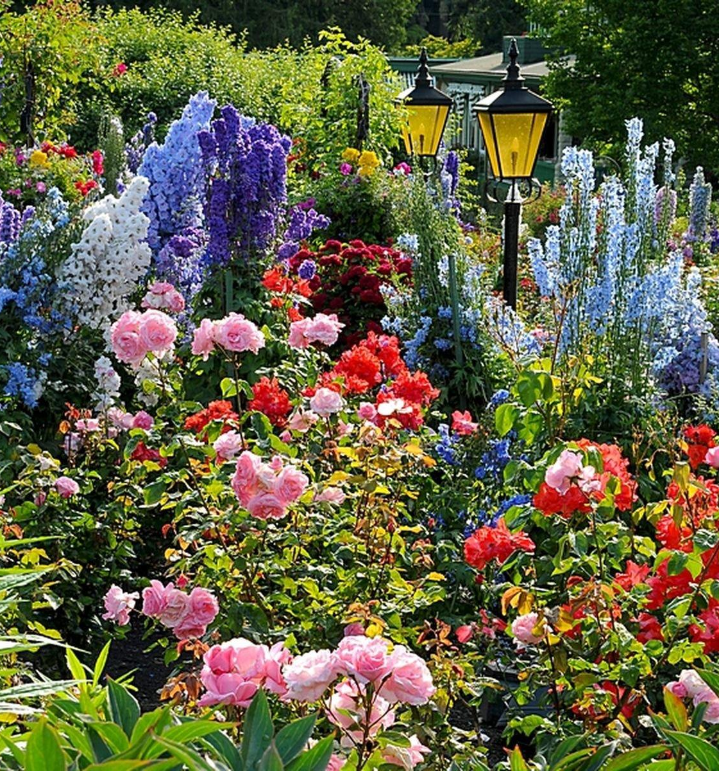
Butchart Gardens
Here is one of the wonderful floral displays in the gardens.
Notes:
https://www.butchartgardens.com/wp-content/uploads/2017/12/rose-garden-DSC_2685-copy-1000x757.jpg

Slide 8
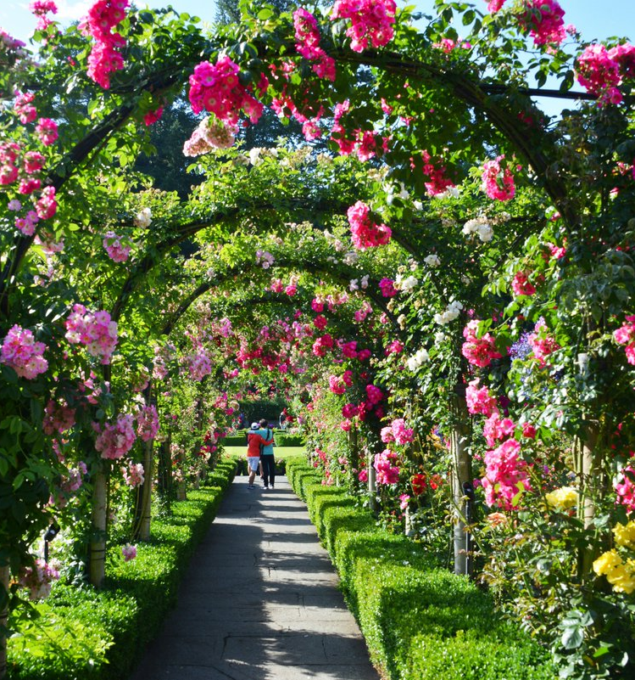
Butchart Gardens
This is the walkway through the rose garden.
8
Notes:
https://www.butchartgardens.com/wp-content/uploads/2017/12/garden-rose-06-1000x533.jpg

Slide 9
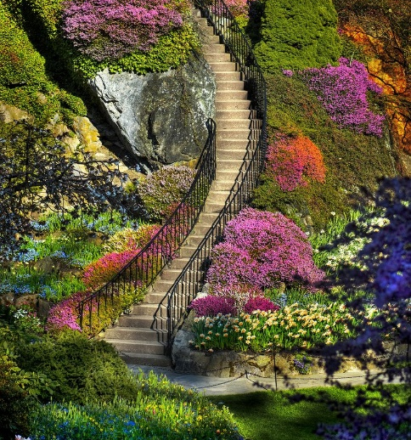
Butchart Gardens
The staircase was built into the hillside and the plants cascade down with it.
Notes:
https://joshuadunns.files.wordpress.com/2016/09/image1.jpg

Slide 10
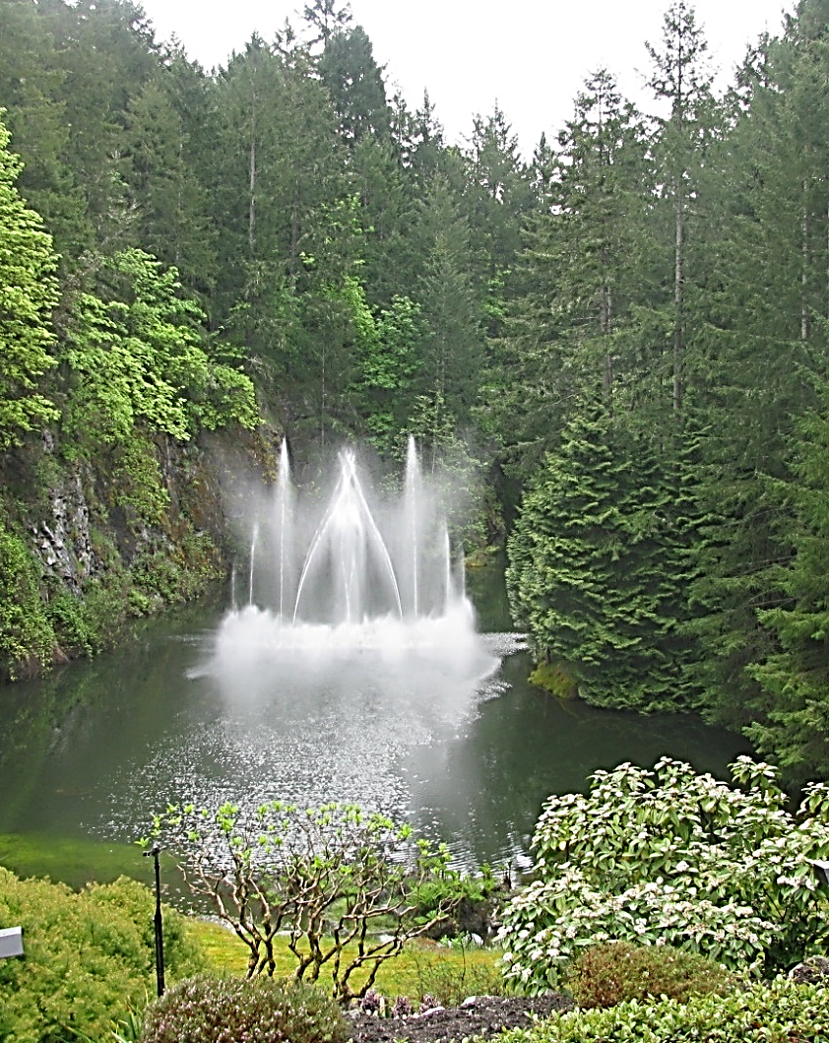
Butchart Gardens
It was difficult to select photos that represent the Butchart gardens. One of my favourites is a magnificent waterfall.
This was constructed on a wall of a disused quarry.
Notes:
Author’s own photograph

Slide 11
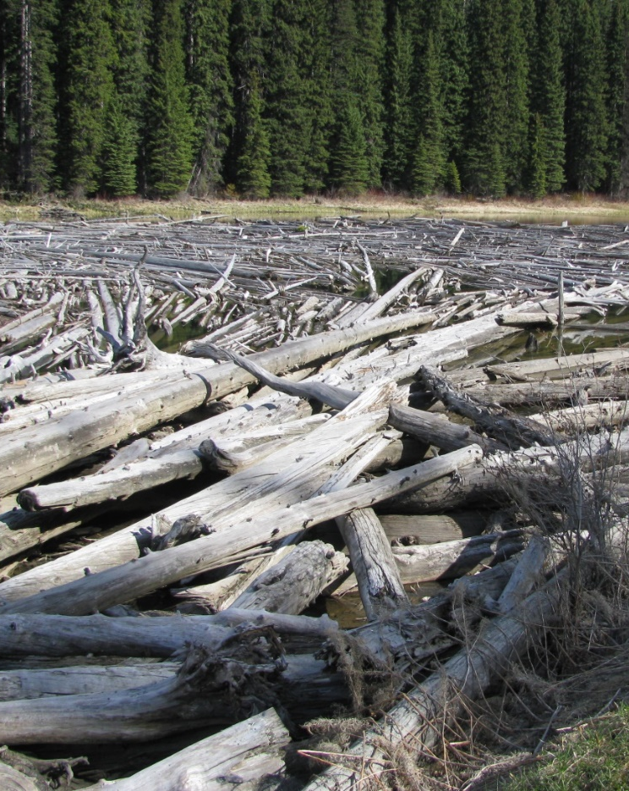
Logging
In British Columbia, over 80% of the land mass is forest. Timber is a major product. These logs have been transported in a river from the source to the mill.
Notes:
Author’s own photograph

Slide 12
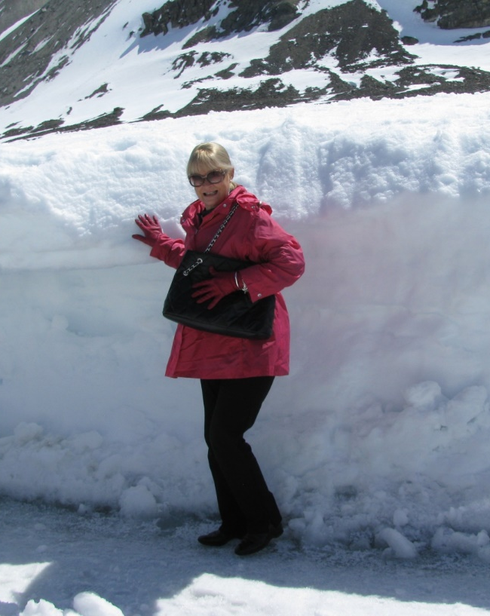
Snowfields
I had never been to a snowfield until Canada. Here is Nola, my partner, standing in front of a glacier.
The glacier moves down-stream at a rate of a metre a year. When it reaches the sea, it breaks off with a sound like thunder. A mass of ice floes are created like mini icebergs.
Notes:
Author’s own photograph

Slide 13
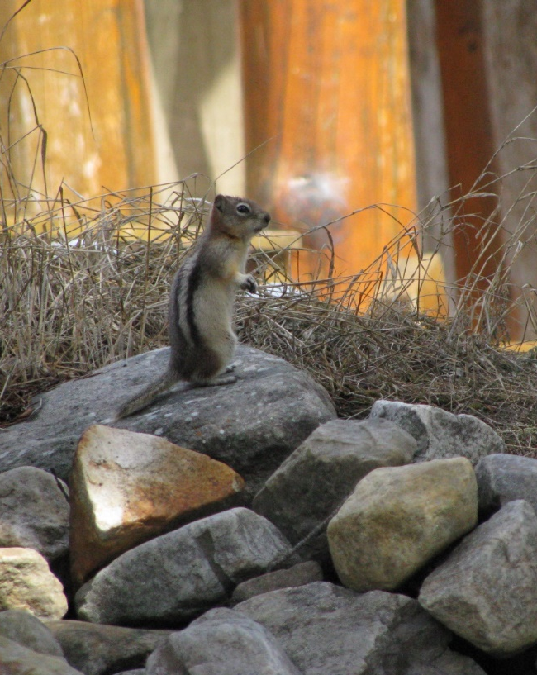
Local Wildlife
This photo has been included just for fun.
I had never seen a squirrel before and was excited to capture this little fellow because he moved so quickly.
Notes:
Author’s own photograph

Slide 14
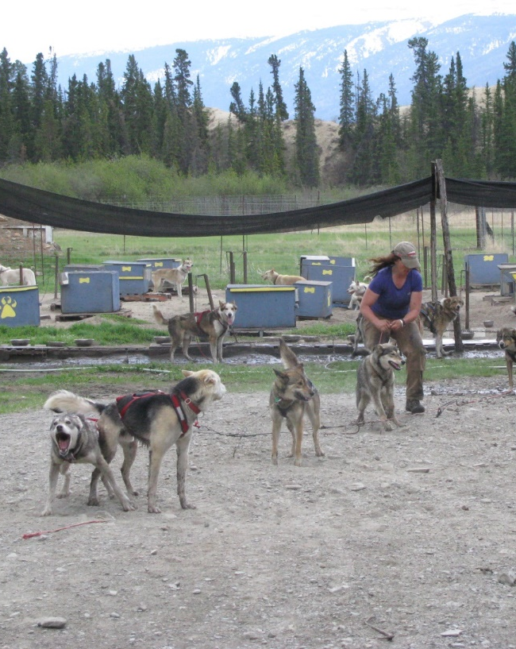
Dog Sledding
While dog sleds are usually used in snow fields, in Canada, for the tourists, there are dog sled trips on bare ground using a wheeled cart. When the dogs are being harnessed, they bark actively because they are anxious to get going.
Notes:
Author’s own photograph

Slide 15
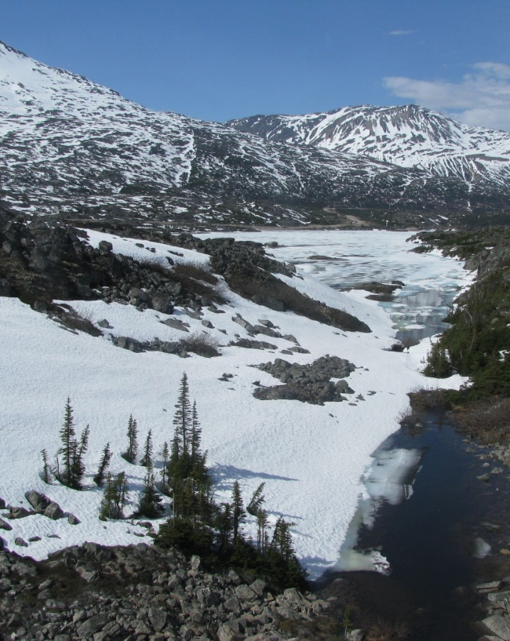
Beautiful Scenery
There are so many beautiful views in Canada, the following photo is just one example of a view which appealed.
Notes:
Author’s own photograph

Slide 16
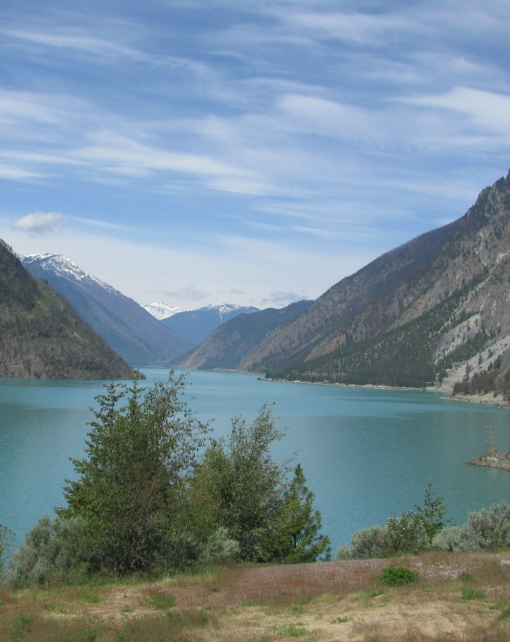
Lake Louise
Lake Louise is a favourite destination for Canadians and overseas visitors. There is a magnificent hotel, a variety of walks from easy to challenging and a lake half a mile wide and a mile long. Its size is deceptive. In winter this lake freezes over enabling many to enjoy ice skating.
Notes:
Author’s own photograph

Slide 17
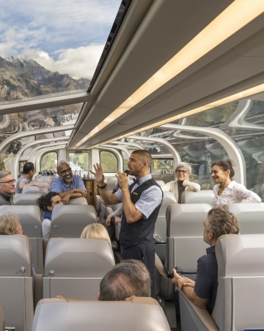
Rocky Mountaineer
The Rocky Mountaineer train has a world-wide reputation. The roof is transparent giving very extensive scenic views. I was excited about taking the trip although it was only two days and I could have had more. There was an overnight stop halfway.
Notes:
https://www.rockymountaineer.com/sites/default/files/styles/paragraph__testimonials__testimonials_image/public/testimonials_image/rocky-mountaineer-host-tells-story-to-guests.jpg?h=79c0c837&itok=P4xupCwQ

Slide 18
Rocky Mountaineer
You can see from this photo that the scenery is really beautiful and this is just one photo of the many we were able to take. You can also see how long the train is. Despite the many carriages, there is only one with a transparent roof.
Notes:
https://www.rockymountaineer.com/sites/default/files/styles/taxonomy__route__route_image/public/route_image/rainforest-to-gold-rush-rocky-mountaineer-train-passes-by-howe-sound.jpg?h=2b874224&itok=4alcS0RO

Slide 19
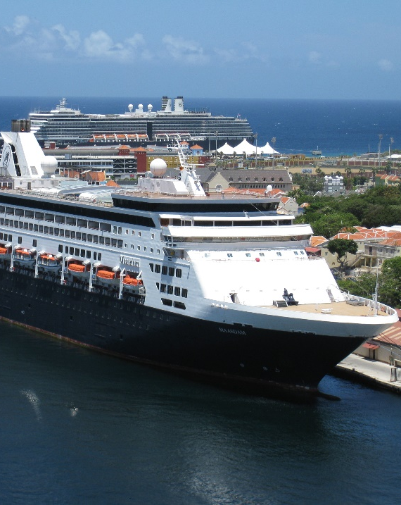
Inland Passage
We cruised on the Maasdam, a small cruise liners of 500 passengers. We boarded at Vancouver and spent a wonderful week visiting several destinations.
Cruising is something we were reluctant to undertake; but now we’ve changed our view.
Notes:
https://upload.wikimedia.org/wikipedia/commons/thumb/7/7a/MS_Maasdam_S-Class_Cruise_Ship_Holland_America_Line.jpg/300px-MS_Maasdam_S-Class_Cruise_Ship_Holland_America_Line.jpg

