Slide 1
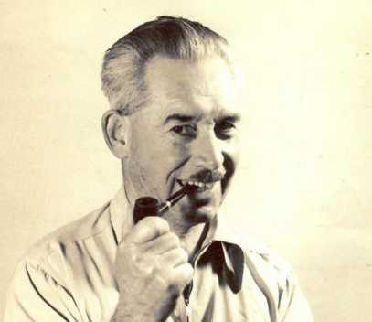
My Grandfather - Ray
Rotary Club of Canterbury: Let’s Stay Connected Project
Notes:
Photo Provided by the Author

Slide 2
The Rotary Club of Canterbury “Let’s Stay Connected Project” has been developed as a response to an identified need within the Aged Care sector.
At times when it’s difficult to connect in person with family and friends, the Rotary Club of Canterbury has pleasure in offering you this booklet, designed to promote conversation, recollection and engagement for those who are in isolation and without their usual social activities.
The booklets have been designed for people in an aged care residence, village or at home to read by themselves, or to have a family or staff member share the booklet with them.
You can download this and other booklets from the Rotary Club of Canterbury website (www.canterburyrotary.org).
Source references for this book are held at the Rotary Club of Canterbury. Contact president@caterburyrotary.org for further details.
Material in this book was reproduced in accordance with Section 113F of the Copyright Act (1968).
Rotary Club of Canterbury: Let’s Stay Connected Project

Slide 3
Rotary Club of Canterbury: Let’s Stay Connected Project

Slide 4
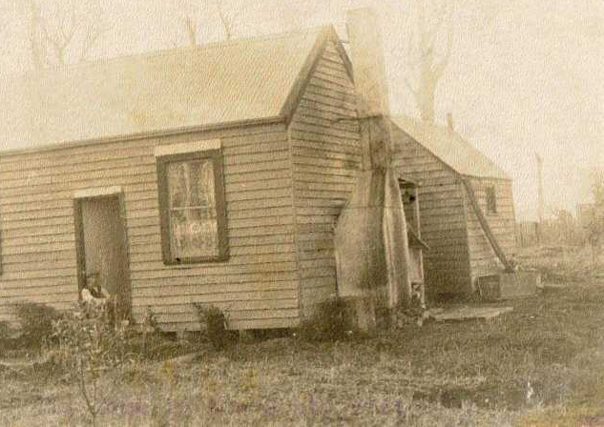
My Grandfather, Ray
My grandfather, Ray, had an interesting life.
Ray was born in East Brunswick in 1891, the second of five children - 4 boys and 1 girl.
Early in the 20th century, the family moved to a farm at Wonyip in Gippsland, Victoria.
An early photo Ray took of his home in Gippsland.
Rotary Club of Canterbury: Let’s Stay Connected Project
Notes:
Photo Provided by the Author

Slide 5
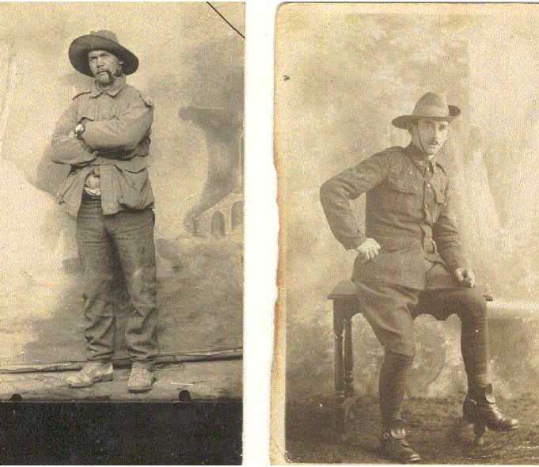
Enlistment
In September 1914, soon after World War I broke out, Ray and his younger brother, Cliff, enlisted in the AIF.
Ray and Cliff were assigned to the 9th Light Horse Regiment.
Photo: Cliff on left; Ray on right.
Ray was 23, Cliff was 22 years old.
Rotary Club of Canterbury: Let’s Stay Connected Project
Notes:
Photo Provided by the Author

Slide 6
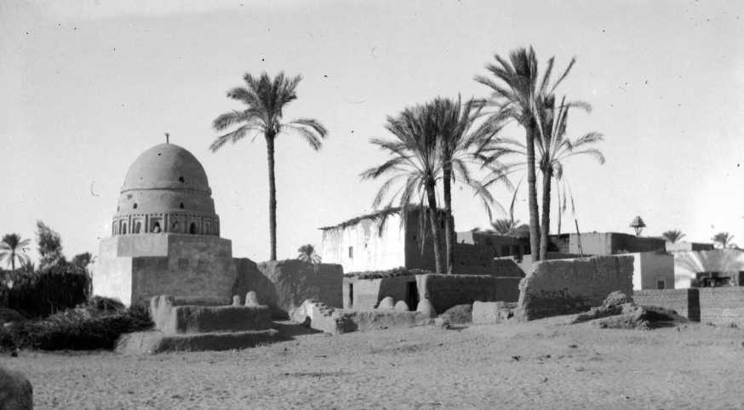
Egypt
After training, they embarked for
Egypt before going on to Gallipoli.
Ray was a keen photographer all his life.
These photos were taken by
Ray in Egypt 1915.
Rotary Club of Canterbury: Let’s Stay Connected Project
Notes:
Photo Provided by the Author

Slide 7
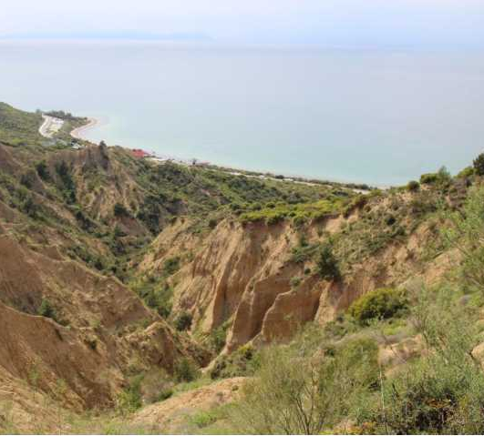
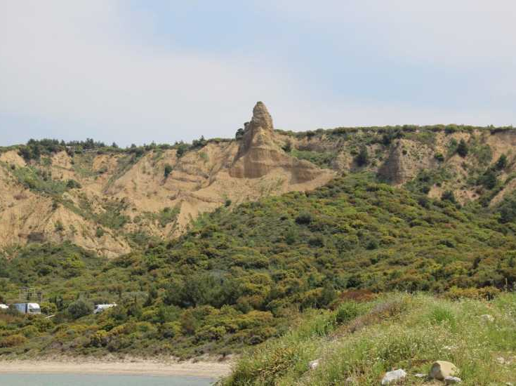
Gallipoli
Ray landed at Gallipoli on the 16th May 1915.
My photos of Gallipoli in 1913.
Rotary Club of Canterbury: Let’s Stay Connected Project
Notes:
Photo Provided by the Author

Slide 8
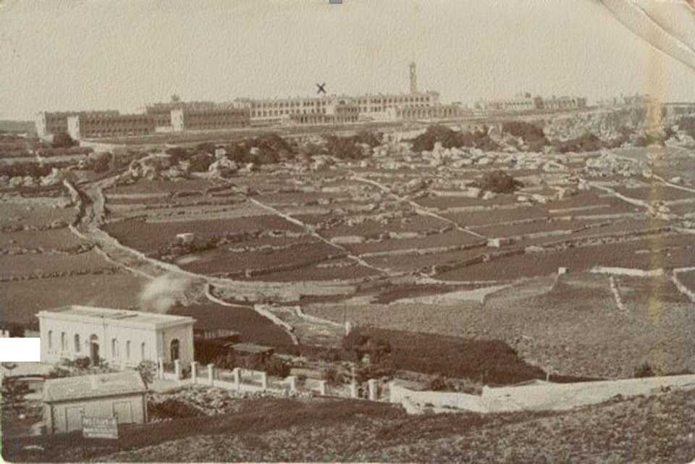
Malta
This is a postcard sent by Ray from Malta. The x marks the spot where he was being treated.
In July Ray contracted enteric fever and was taken to the Imtarfa Hospital on Malta.
On the back of the card he wrote:
Enteric is no joke. I've had 5 weeks of it.
Rotary Club of Canterbury: Let’s Stay Connected Project
Notes:
Photo Provided by the Author

Slide 9
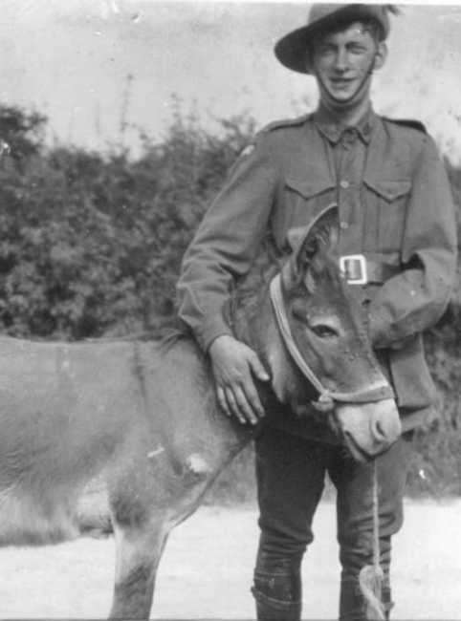
Salisbury
From Malta, Ray was taken to hospital in London. He was finally discharged in June 1916.
This is one of Ray's photos (1916) taken at Salisbury, UK of his friend, Roy Burrell, and a donkey they 'captured' to carry around their photographic gear.
Page 7 of 19
Rotary Club of Canterbury: Let’s Stay Connected Project
Notes:
Photo Provided by the Author

Slide 10
France
After he was discharged from hospital, Ray was sent to France.
He was wounded by a bomb in France in November 1916.
There were bomb fragments in his leg until the day he died.
Photo of Ray on 'Floss'.
Page 8 of 19
Rotary Club of Canterbury: Let’s Stay Connected Project
Notes:
Photo Provided by the Author

Slide 11
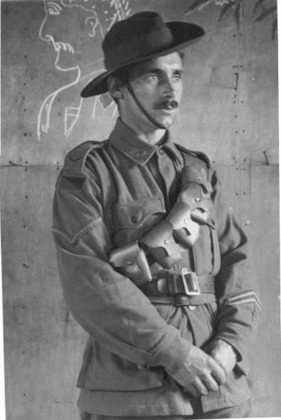
Return to Egypt
After another stay in hospital in England, Ray was re-united with his brother in Egypt.
They spent the rest of the war on the 'Desert Campaign' in Palestine.
Photo of Ray in England, 1917, before returning to Egypt for the Desert Campaign.
Rotary Club of Canterbury: Let’s Stay Connected Project
Notes:
Photo Provided by the Author

Slide 12
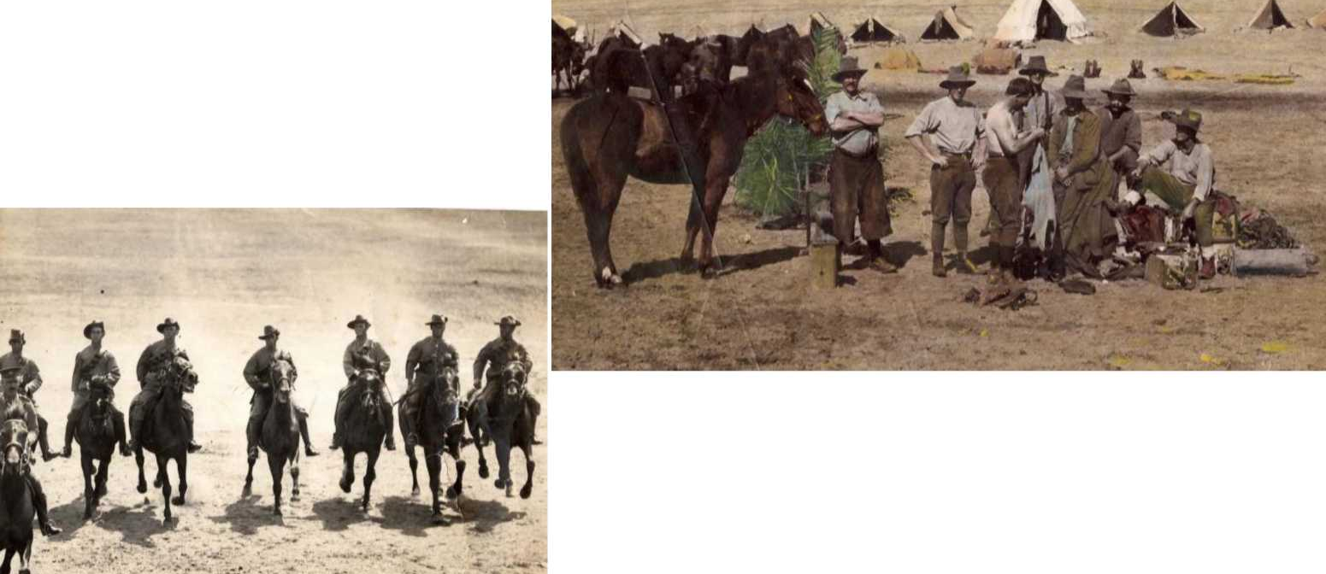
The Lighthorsemen
Ray's photos of Lighthorsemen in the desert
Rotary Club of Canterbury: Let’s Stay Connected Project
Notes:
Photo Provided by the Author

Slide 13
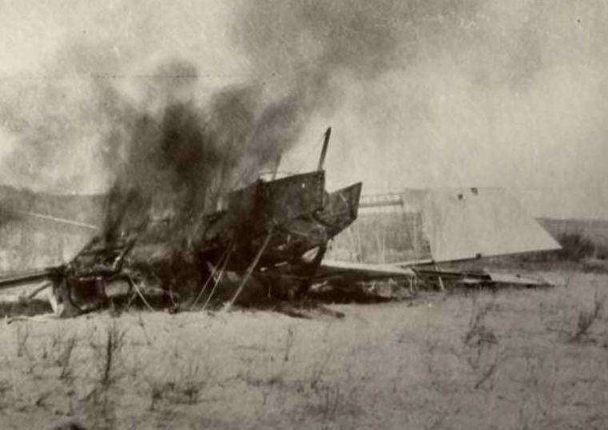
Ray's photo of Wreckage of a German Gotha aircraft in the desert.
Cliff
Sadly, Ray's brother, Cliff, died of malaria in October 1918 in Damascus. He had served for four years without a serious injury.
Rotary Club of Canterbury: Let’s Stay Connected Project
Notes:
Photo Provided by the Author

Slide 14
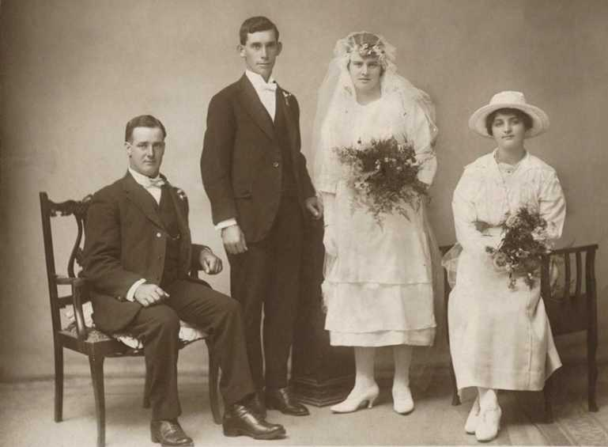
Ray marries
After he returned to Australia, Ray worked for a short while as a press photographer.
In 1921, at the age of 29, Ray married my grandmother, Mary. They had 3 daughters.
Rotary Club of Canterbury: Let’s Stay Connected Project
Notes:
Photo Provided by the Author

Slide 15
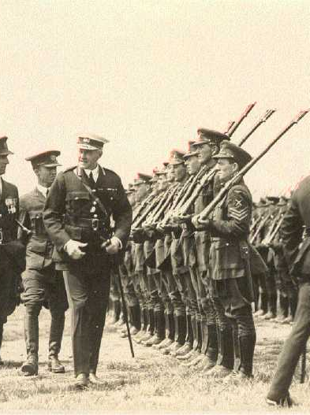
RAAF
In 1922, Ray enlisted in the newly formed RAAF.
His main job was to take aerial photographs to help with mapping, but he took other photos too.
Ray resigned from the Air Force
in 1924.
Ray's photo: Lord Forster reviewing the RAAF
Rotary Club of Canterbury: Let’s Stay Connected Project
Notes:
Photo Provided by the Author

Slide 16
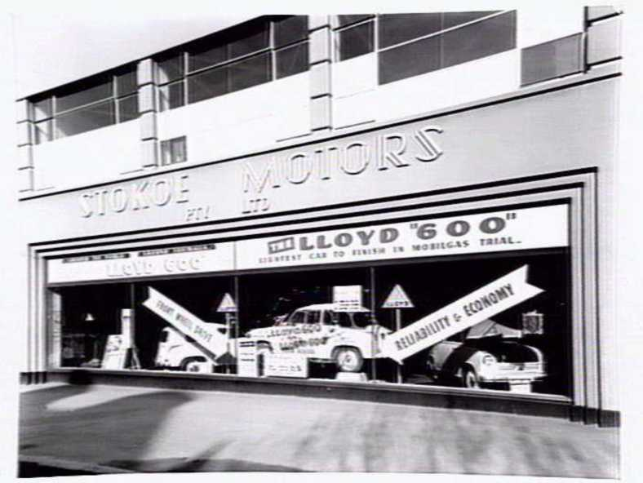
Civilian Life
For many years, Ray worked as an advertising manager for Stokoe Motors.
Stokoe Motors showroom built 1935, 265 Exhibition St, Melbourne.
They sold lots of different models of cars, including Willys and Sunbeam cars.
Rotary Club of Canterbury: Let’s Stay Connected Project
Notes:
Photographer: Lyle Fowler (1956) https://www.slv.vic.gov.au/pictoria/gid/slv-pic-aab89041

Slide 17
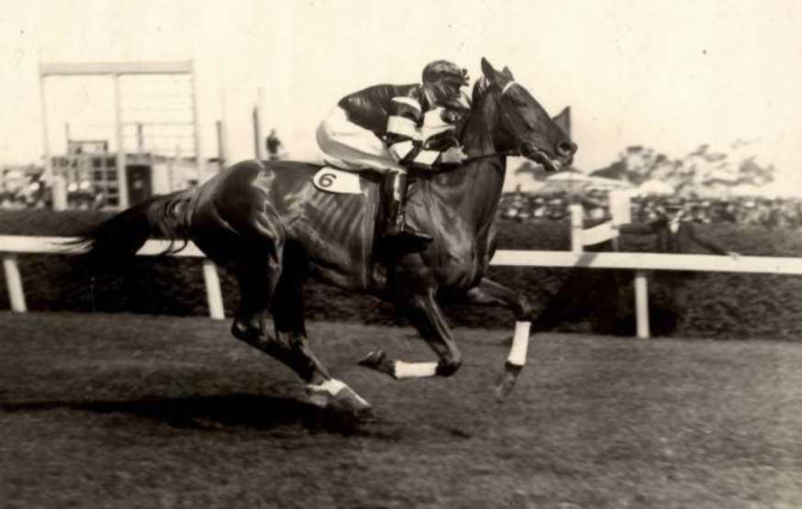
At the Races
Ray also loved horse racing. He published a book on betting systems in 1947.
He used to call the country races at places like Stony Point.
Ray's photograph of Phar Lap with Jimmy Pike.
Rotary Club of Canterbury: Let’s Stay Connected Project
Notes:
Photo provided by the Author

Slide 18
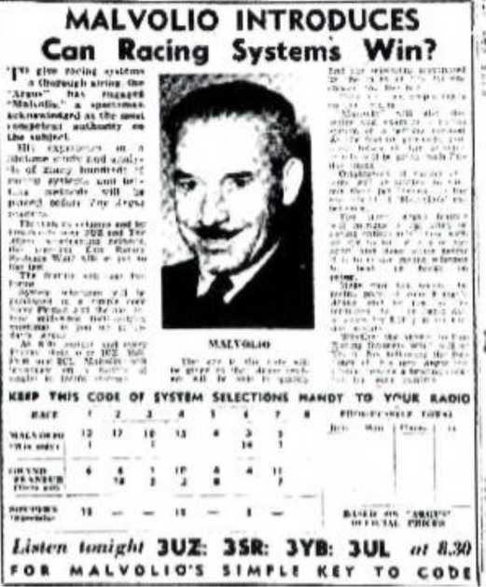
AKA Malvolio….
During the 1950s Ray wrote for the racing pages of The Argus under the name of 'Malvolio'.
He also broadcast racing tips on 3UZ.
Ray’s articles from The Argus, 1950
MALVOLIO in:
Gin Racing Systems Win?
KlIP THIS! COLUMNS OP IAHIH POSITIONS HANOT TO YOU* RADIO
cmr— | —1—1— |  |  | —1— |  | —I—l—
MALVOiiO fWto tyofmm) | 1 11 | 1 4 | • 7 | 1 • | S | 11 11 | • |  | 1 Wta. |  | N— | &NImA
 |  |  |  |  |  |  |  |  |  | S4 | t. | C4R.IM
HUNS SUtMtUft <Nm lyMMl | _ • | , 14 | 4 t | 4 5 | 1 1 | 11 | - |  | 41# | f# | 147 | 414.4.4
looms |  |  |  | " | " | “ | 4 |  | - | — 1# | 4t | 41MJ
 |  |  |  |  |  |  |  |  |  | ■ PINK
LMm h SSR—IYI—IUL at Ml Nalfi*—IUZ I.M (Mi m» HmI POR CORRSCT ORMR OP RACO
Rotary Club of Canterbury: Let’s Stay Connected Project
Notes:
Photos provided by the Author

Slide 19
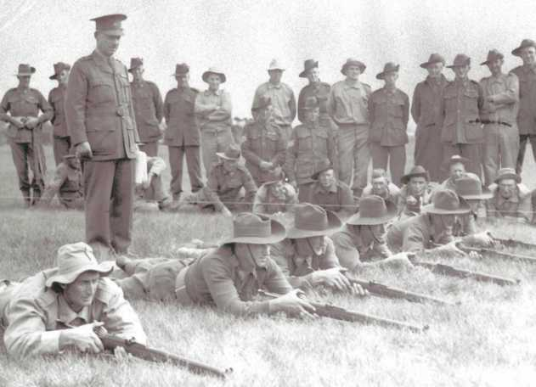
Re-enlisting
When World War II broke out, Ray, at the age of 50, re-enlisted in the army.
He had many assignments during the war, including training troops.
Ray was honourably discharged from the army in 1944 after breaking his wrist playing table tennis!
This photo shows Ray training recruits at Royal Park.
Rotary Club of Canterbury: Let’s Stay Connected Project
Notes:
Photo: The Argus, 1970

Slide 20
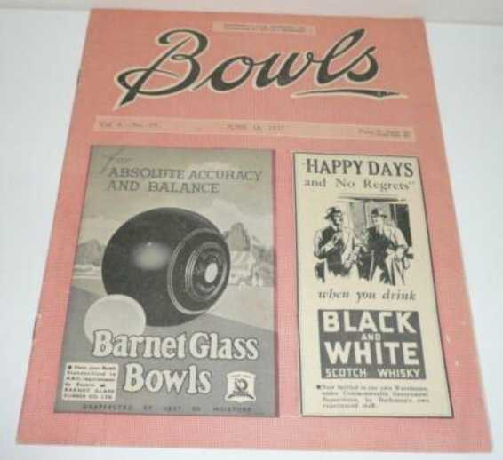
Ray – Bowls, Books and Cameras
Ray was a keen bowler. He edited the Bowls Magazine for several years in the 1960s.
He maintained his interest in photography, and was a member and judge for the local camera club.
In his 70s, Ray had his last job at Chadstone Shopping Centre in a camera shop.
Rotary Club of Canterbury: Let’s Stay Connected Project
Notes:
Photo provided by the Author

Slide 21
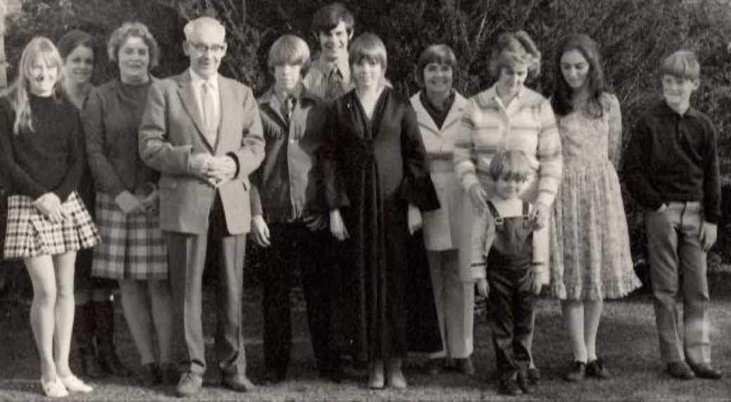
My Grandfather, Ray
Photo: Ray and family on his 80th birthday, 1971.
Rotary Club of Canterbury: Let’s Stay Connected Project
Notes:
Photo provided by the Author

